Slide 1
JAVA History
Simple, Portable, Reliable, Powerful
1991: Announcement of a new language called “Oak”
1992: The Green Project team demonstrated the application of their new language
1993: World Wide Web came in, the team came up with the idea of applets…
1994: HotJava. It makes Java popular among the internet users.

Slide 2
Continued…
1995: Oak renamed as Java. Microsoft and Netscape now support Java.
1996: Java establishes itself not only as a leader in Internet Prog. but also general purpose OOPL. Releases JDK 1.0

Slide 3
Java Features
Compiled and Interpreted
Platform- Independent and Portable(bytecode and primitive data-types)
Object- Oriented
- Java comes with Extensive set of classes, arranged in packages.

Slide 4
Robust and Secure
- Strict compile and runtime data type checking.
- Garbage collected language
- Incorporates Exception handling
- absence of pointers
Distributed
- RMI
- enables programmer at multiple locations to work on a single project

Slide 5
Simple, Small and Familiar
- Many features of C and C++ that cause redundancy or create unreliable code are not part of Java
Multithreaded and Interactive
High Performance (due to bytecode and multithreading)

Slide 6
Java and C++
Java does not support:
Operator Overloading
Template classes
Multiple Inheritance
Global variables
Pointers
Destructor()
Header files

Slide 7
Java and Internet
Internet users can use Java to create applets and run them locally
They can also use Java enabled browser to download an applet
Internet users can also set-up their websites which contain applets, that can be used by remote users of Internet
Hence, Java is popularly known as Internet Language

Slide 8
Java Virtual Machine(JVM)
Compiler translates source code into machine code for a specific computer
Then, how does Java achieve architectural neutrality?
javac produces the intermediate code for a machine that does not exist….i.e. the JVM, existing inside the computer memory.

Slide 9
Converting bytecode into machine code
Java Program
Java Compiler
Bytecode
Bytecode
Java Interpreter
Machine code

Slide 10
Simple Java Program
class Sample
{
public static void main(String args[])
{
System.out.println(“Java is better…”);
}
}

Slide 11
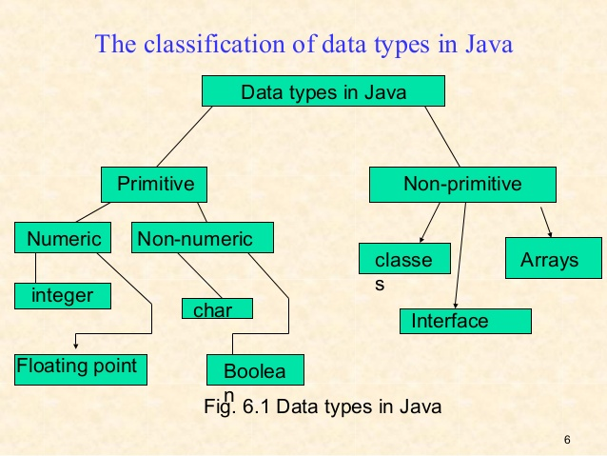
Data types and Size

Slide 12
There are eight primitive data types
Name them
boolean, byte, char, double, float, int, long, short
In bytes, how long is the short data type? The int data type, the long data type?
In bytes, how long is the float data type? The double data type?
How long is the char data type?

Slide 13
Primitives sizes and Ranges
PRIMITIVE | SIZE IN BITS | RANGE
byte | 8 bits | -128 to 127
short | 16 bits–2bytes | -32,768 to 32,767
int | 32 bits- 4bytes | -2, 147, 483, 648 to 2, 147, 483, 647
long | 64bits - 8bytes | -9,223,372,036,854,775,808 to 9,223,372,036,854,775,807
float | 32 bits -4bytes | 3.4e-038 to 1.7e+0.38
double | 64 bits -8bytes | 3.4e-038 to 1.7e+308
char | 16 bits–2bytes | One character
boolean | One bit | True or false(1 or 0)
string | 16 bits per char | Not applicable

Slide 14
Notations
Hungarian notation:
First letter of Each word is capitalized.
class FirstJavaCode
Camel Case notation:
First letter of Each word is capitalized except first word
void computeAverageOfStudents(….);
All Caps : [ Constant/final variable]
FEE_DUE_DATE
All Smalls: [ keyword, object, package, variable, file ...]
fee_due_date

Slide 15
Command Line Arguments
class DemoCommandArg
{
public static void main(String[] args)
{
for(int i=0;i< args.length;i++)
{
System.out.println(args[i]);
}
}
}

Slide 16
javac DemoCommandArg.java
java DemoCommandArg 10 20 30
Output :
10
20
30

Slide 17
Read statement
import java.io.*; // import IO package
public class ReadString { public static void main(String[] args)throws IOException { String yourname;
BufferedReader reader; //create BufferedReader object
reader=new BufferedReader(new InputStreamReader(System.in));
System.out.print(“Enter your name:”);
yourname=reader.readLine();
System.out.println(“Your name is ”+yourname); } }

Slide 18
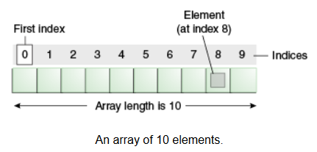
Arrays in Java

Slide 19
Creating arrays
Declaring the array:
typename arrayname[];
typename[] arrayname;
Ex:
int numbers[];
float averages[];
int[] numbers;
float[] averages;

Slide 20
2. Creating memory locations:
After declaring an array, we need to create it in the memory.
arrayname= new typename[size];
Ex:
numbers= new int[5];
averages= new float[10];
* Combining these two steps:
int numbers[ ]= new int[5];
float[] averages= new float[10];

Slide 21
3. Initialization of arrays:
arrayname[index]= value;
Ex:
number[0]= 35;
number[1]= 40;
.
.
number[4]= 20;
OR
int numbers= {35, 40, 20, 57, 20};

Slide 22
Array of Objects
Array of objects are created in two steps:
i. Declaring the array of objects in memory:
MyClass ObjectArrayName[ ]= new MyClass [5];
or
MyClass[] ObjectArrayName= new MyClass [5];
ii. Calling constructor for each of the object in the array:
ObjectArrayName[0]= new MyClass();
:
ObjectArrayName[4]= new MyClass();

Slide 23
Muti-dimentional arrays
Consider 2D arrays:
int myarray[ ][ ]= new int[3][4];
int myarray[ ][ ]= {(0,1,1), (1,0,0)};
int myarray[ ][ ]= {(0,1,1),
(1,0,0)
};
int x[ ][ ]= new int[3][ ];
x[0]= new int[2];
x[1]= new int[4];
x[2]= new int[3];

Slide 24
String Handling in Java
Strings can be created using character arrays
A Java string is an instantiated object of the “String” class, residing in lang package.
Syntax:String strname= new String(“value”);
String array: String strarr[ ]= new String[3];
The above statement will create a array of size 3 and will hold 3 string constants.

Slide 25
String Methods
Following are the most commonly used string methods:
s2=s1.toLowerCase();
s2=s1.toUpperCase();
s2=s1.replace(‘x’, ’y’);
s2=s1.trim();
s1.equals(s2);
s1.equalsIgnoreCase(s2);
i=s1.length();

Slide 26
s1.charAt(n);
s1.compareTo(s2);
s1.concat(s2);
s1.subString(n);
s1.subString(n, m);
String.valueOf(s);
p.toString();
s1.indexOf(‘x’);
s1.indexOf(‘x’, n);

Slide 27
Selection Statements
if (condition expression)
{
//true_block_statements
}
else
{
//false_block_statements
}

Slide 28
Class IfElseTest
{
int even=0, odd=0;
int[ ] number={50,51,65,56,71,82};
public static void main(String args[])
{
for (int i = 1; i < numbers.length; i++)
{
if (numbers[i] % 2 == 1)
even+=1;
else
odd+=1;
}
System.out.println(“Even: ”+even+” Odd: ”+odd);
}
}

Slide 29
Looping statements
while
do-while
for
Jumps in Loops:
break;
continue;
continue label;

Slide 30
m=5;
for( ;m!=100; )
{
System.out.println(“m= ”+m);
m=m+5;
}

